Slide 1
Week 12: Document Processing
W266: Natural Language Processing

Slide 2
Peeking ahead...
Week 1- 2: NN Basics & Training
Week 3: Classification & Sentiment
Week 4: Part of Speech + Parsing
Week 5: Convolutional Neural Networks (CNNs)
Week 6 - 7: Language Models
Week 8: Machine Translation
Week 9: Advanced MT: Transformers & Transfer Learning
Week 10: Summarization and a touch of question answering
Week 11: Entities/Information Extraction
Week 12: Document Processing
Week 13: Information Retrieval

Slide 3
Announcements
Projects
Due Saturday 04/10 11:59 pm PST (hard deadline!)
~ 1 to 2 weeks
Your presentations in class 04/12-04/17.
Questions?
Concerns?

Slide 4
The plan...
Project check-in
Documents - easy, no?
How can we represent documents?
Neural architectures for document processing

Slide 5
Project FAQ
Page limit: 4-6 pages. "I don't have enough time to write a shorter paper!"
The best projects have been (well) within the word limit. Short and to the point, with interesting analysis.
If you go a bit over because of a reference section? Sure. Image captioning project with lots of fun examples in an appendix? Great!
Certainly don't have any hard rules "6 pages and one word? zero!", but be respectful of our time! :)
Presentations
Focus on the interesting parts of your problem. Know your audience. (Do not waste time explaining what BERT is.)
Probably you want to put some slides together, rather than just present the report pdf.
Aim for 5 minutes. Usually it takes a little longer than you expected. Then a few people will have questions.
If you are a cross-section group, you will only present in one section. Express your preference in this Google Project Submission Form.
Reports
Follow the instructions on the GitHub to submit (you must complete the Submission Form)
Make sure you have something interesting to say, not just a table of throwing models at the wall.
Due April 10 (Saturday) at 11:59 PM. Do not submit them late. 10% penalty for each day late.

Slide 6
Project check-In
Who has their data? (hopefully, everybody)
Who has a baseline? (hopefully, everybody)
Experiments to improve baseline?
Analysis?
Problems?

Slide 7
Key Learnings Review

Slide 8
Last Week: Summarization
Types of summaries:
Abstractive: “explain in your own words”
Extractive: build summary from existing text
Summarization “pipeline” (not standard):
Choose relevant sentences (document and sentence-level)
Arrange sentences in order (sentence-level)
Clean up output (sentence and word-level)
For QA, all steps conditioned on query.

Slide 9
Last Week: QA Task Variants
Question-Answering provides answers to plain text questions based on a passage, document, or corpus*
Span annotation: Given a question and passage, highlight the text in the passage that answers the question (SQuAD, Natural Questions). Most popular
Multiple Choice: Given a question and a passage, select the correct answer to multiple choice question (RACE, Children’s book test, MC Test) Similar to edu standardized tests
Free-form (/summarized) answers: Given a question and supporting text, generate a free-form answer (MS MARCO, Conversational QA - CoQA). Evaluation Issues?
Retrieval: Given a question and a supporting document or corpus, retrieve the sentence that answers the question (WikiQA, Yahoo Answers!, ReQA SQuAD, ReQA Natural Questions) Most useful for applied tasks?
* Multimodal Questions about an image (CLEVR)
Notes:
Multimodel is red and starred since it's fairly different than the other text based QA tasks.

Slide 10
Document Tasks & Complexities

Slide 11
Many important document related tasks
Document classification
Document summarization
Document similarity/clustering
Document discourse (coherence and cohesion)
Document retrieval (next week)
Automated Essay Grading
….

Slide 12
Brainstorming
Great… we have done a lot of that before in the class!
But... what’s different with documents? What’s new?
...
...
… so.. can we just use the techniques we learned? Why or why not?
Notes:
Length
Internal structure...

Slide 13
Document Characteristics
Documents can be…
Longer
Paragraph to multiple sections
Structured
Sections, Chapters
Typed
Newspaper articles, research papers, essays, novels, short stories, legal briefs, abstracts (think of types as genres with structural characteristics that mean they’re more alike and less like documents in other genres)

Slide 14
Document Structure
Common organization:
Words are organized in sentences
Sentences are organized in paragraphs
Paragraphs are (often) organized in sections
Is this arbitrary? Of course not!
Linguists speak of a number of different relations:
Cohesion Relations - which words are selected for a sentence
Coherence Relations - how sentences are ordered
Discourse Relations - how arguments are constructed, proven, refuted

Slide 15
Applicability of what we learned so far in class
Let’s look at the tasks:
Classifications:
BERT et al… only works for ~ paragraph
CNNs are technically not limited in size, but good luck to running a CNN over 100 pages and expecting meaningful results..
Summarization:
T5 & Pegasus… but only works for ~paragraph
Similarity:
Word embeddings and sentence embeddings… but how does that scale to documents?
Coherence, Cohesion etc?
What’s that? Didn’t even come up so far...

Slide 16

An Extreme Example
“Les Miserables” has > 500k words.
Can we classify by truncating after 500 words?
Can we summarize by just looking at 500 words? You probably miss the conclusion. And just about everything else.
Can we do argument analysis with 500 words?
Documents are different beasts...

Slide 17
So how can we approach the problems
Some independent strategies:
Use existing approaches on short sections and find ways to stitch information together, i.e., exploit hierarchical structure.
Relax size constraints of existing BERT-derived approaches and hope they give more meaningful results. (It is a long way though from 500 to 500k ...)
Use altogether different approaches to targeted problems

Slide 18
Documents Representations

Slide 19
What about Term Document Matrices?
doc1
doc2
doc3
Three documents in term document matrix:
I like dogs
I prefer cats
I like dogs and cats and fish
Each doc represented by a vector (a bag of words)
Vectors contain counts (tf) or weights (tf*idf from information retrieval)
Each word in doc is treated as a dimension so can compute “similarity” as cosine of angle between vectors. (Vector Space Model)
and
cats
dogs
I
like
prefer
fish

Slide 20
What about Term Document Matrices?
We’ve seen term document matrix in earlier weeks:
Good
Simple counts of words
No length constraint on documents, just size of vocabulary
Bad
Documents represented as sparse vectors of words in the vocabulary
Document is just a histogram of word islands, structure is lost

Slide 21
What document features might we want to represent?
Brainstorm:
What are the important parts of a document that we might want to represent?
Just the words? How about phrases, entities, actions, relations
How might this vary by task (e.g. classification vs. summarization vs. retrieval)?
For summarization, I need to communicate the information given the input query
For classification, I need to produce one or more class labels
Notes:
Just talk in terms of simple term document matrix. The “terms” in the matrix can be the words or they can be other things like entities, grammatical roles and relations, etc. If creating a summary, I’m going to need to make sure I convey the information about entities and events and their relations. That means it’s important to represent those in the terms. For classification, I need to predict labels which may not require the same kinds of explicit identification of entities and relations.

Slide 22
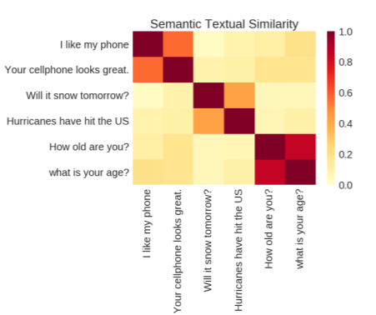
Neural Sentence Representation
Given advantages of representing words as dense vectors, how can we represent a sentence as a dense vector?
Recipe: Use skip-thought sentence prediction task to build model that can produce a 512-dimensional vector representation of each input sentence.
Combining word2vec embeddings AND USE sentence embedding produces best classification results
From: Universal Sentence Encoder
Notes:
Skip-thought task predicts previous and next sentences based on sentence in the middle.
Other examples of models that represent sentences as vectors come from Sent2vec and from sentenceBERT

Slide 23
What is an embedding doing?
Learning a set of weights that represent something and are most helpful to making an accurate prediction on some task
Weights can be pre-computed
Weights can be enhanced via back-propagation/fine-tuning during training
Weights can represent complex features through reduced dimensionality
Are we asking one embedding to do too much work when applied to docs?
Notes:
Some discussion about dimensionality here....

Slide 24
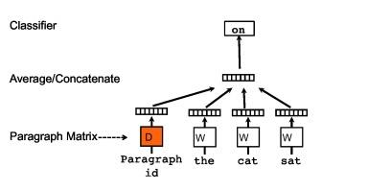
Multi-sentence embeddings
Extend word2vec by building paragraph embeddings while learning a language model.
Recipe: In training, run sliding window over text and predict next word based on previous n words. Each paragraph in text has associated vector that is averaged with the vectors of context words to make prediction.
The result is a set of embeddings for all the words and a second set of embeddings for all the paragraphs in the corpus.
Inference on the corpus can use any combination of paragraph and word embeddings
From: Distributed Representations of Words and Documents (Doc2Vec)
Notes:
W matrix contains the word embeddings
D matrix has an embedding for each paragraph in the training corpus

Slide 25
Document Classification and Comparison

Slide 26
Document structure
Documents are built hierarchically, as illustrated by an outline.
Sentences consist of words
Paragraphs consist of sentences
Documents are made up of paragraphs
Can we re-use this hierarchical structure to make better representations of documents for better document classification results?

Slide 27
Architecture based solutions

Slide 28
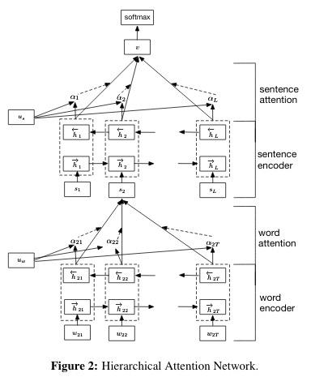
Architectural Solutions
(Pre-transformer) Hierarchical Attention Models
Encoders for words and sentences using stacked bi-GRU
Model forms a document vector (using words and sentences) which is used for classification
Word attention used to make better sentence encoding
Sentence attention mechanism rewards sentences that most help correct classification predictions
Worth noting that highest number of avg words in test corpora is 325.6 (IMBD review)
From: Hierarchical Attention Networks for Document Classification

Slide 29
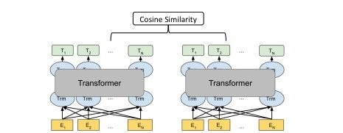
Document comparison
What if I want to compare two documents to see if they are semantically or topically similar?
Related article suggestions
Paper citation suggestions
Parallel text for translations
We can teach twin encoders to produce a vector for each document so their cosine similarity is greater than between any other document pair
Dual Encoder architecture is used in a variety of systems.
Many systems constrained by length of input!
From: Beyond 512 Tokens: Siamese Multi-depth Transformer-based Hierarchical Encoder for Long-Form Document Matching (SMITH)

Slide 30
Hierarchical Transformer Document Encoder
Two problems to solve:
We can only encode the first n words in a document where n can be as low as 250.
We need a complex representation of documents that leverages their hierarchical structure

Slide 31
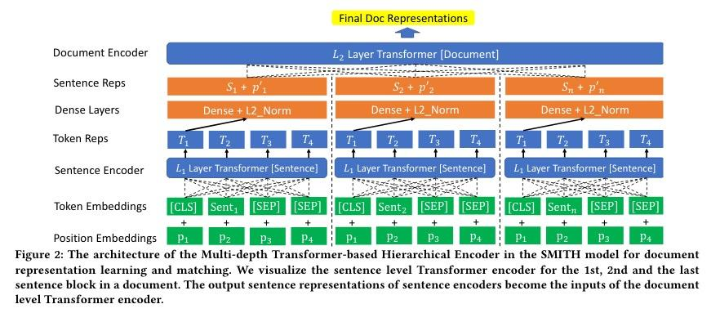
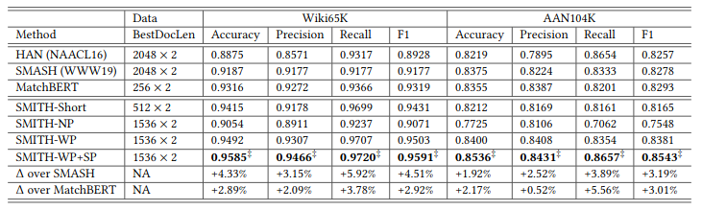
One encoder: leveraging self-attention architecture
Use multiple layers of transformers to represent words, sentences, etc
Use Dynamic Sentence Block Masking and Masked Sentence block prediction
Document vectors are used to:
Find related Wikipedia articles
Find papers that are good citation
Increases input text length to 2048
From: Beyond 512 Tokens: Siamese Multi-depth Transformer-based Hierarchical Encoder for Long-Form Document Matching (SMITH)

Slide 32
Document partition solutions

Slide 33
Break document into parts; aggregate scores
Multi-passage BERT
Used in open domain question answering
Recipe:
Break document into passages using a sliding window
Classify each passage using CLS
Rank passages
Could you score document based on max passage score?
clinicalBERT-multi
Make diagnosis of patient based on presentation at admission to hospital
Recipe:
Break document down in to sections
Classify each section based on CLS
Assign probability to each of 12 conditions
Aggregate scores over all sections using max and avg probability for each condition

Slide 34
Transformer extension solutions

Slide 35
Brainstorming
Transformers have quadratic compute cost in input length n. Not ideal...
Review: why quadratic?

Slide 36
Brainstorming
Transformers have quadratic compute cost in input length n. Not ideal...
Review: why quadratic?
[CLS] I ride my bike to the red house
[CLS]
I
ride
my
bike
to
the
red
house
x | x | x | x | x | x | x | x | x
x | x | x | x | x | x | x | x | x
x | x | x | x | x | x | x | x | x
x | x | x | x | x | x | x | x | x
x | x | x | x | x | x | x | x | x
x | x | x | x | x | x | x | x | x
x | x | x | x | x | x | x | x | x
x | x | x | x | x | x | x | x | x
x | x | x | x | x | x | x | x | x
self-attention calculations

Slide 37
Brainstorming
Transformers have quadratic compute cost in input length n. Not ideal...
Review: why quadratic?
Any thoughts how one could only use a subset of attention calculations such that:
The most relevant attention calcs are hopefully still captured, and
The number of attention calculations grow linearly with n
[CLS] I ride my bike to the red house
[CLS]
I
ride
my
bike
to
the
red
house
self-attention calculations: a reasonable subset (fill in!)

Slide 38
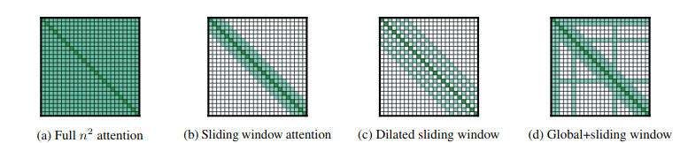
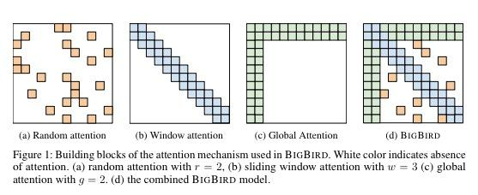
Extending transformers’ range
Longformer (4096 token input):
BigBird (4096 token input):

Slide 39
Structure Considerations
(A Discourse into Linguistic Aspects)

Slide 40
Let’s get philosophical… what is a document?
In one sense it is just a sequence of text.
In another sense it is a structured sequence of text where the structure helps to impart meaning.
Brainstorm:
Is a sentence equivalent to the sum of its words?
Is a document equivalent to the sum of its sentences? Or paragraphs?
Are there relationships across sentences?
Are there structures in arguments?

Slide 41
Application: Essay Grading
Automated essay grading applications look for a number of features to assign a score such as coherence and argumentation structure.
Poor local coherence examples:
Mark ate some apples. He lives in California.
Mark lived in Brooklyn. He likes string quartets.
Poor local argumentation examples:
Mark is rarely late for class, therefore he enjoys spaghetti.
Mark drives a car, therefore he reads many books.
A good essay should maintain good coherence throughout the text (not just between a sentence pair) and present a well structured argument to reach a conclusion.
Notes:
Unclear relations between the two sentences in coherence. Why does sentence 2 come after sentence 1? How are they connected?
Unclear relations between premise and conclusion in example argumentation.

Slide 42
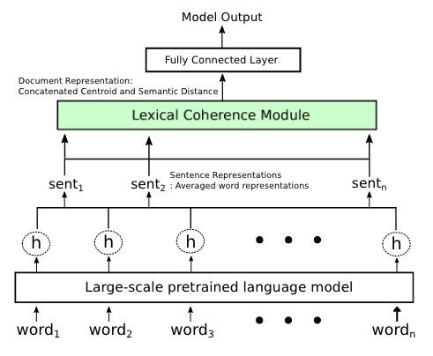
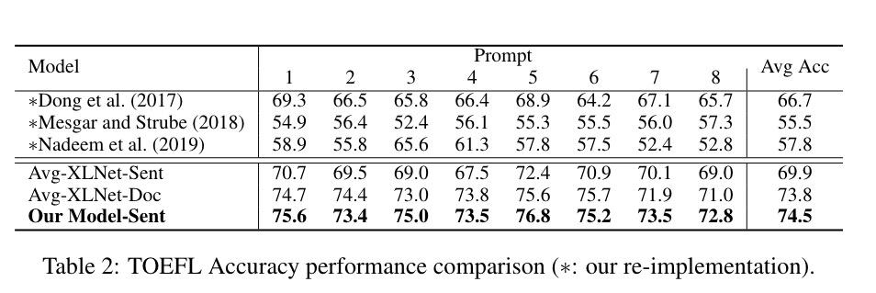
Neural Local Coherence Model
Idea: Emulate sequential nature of human reading!
Average XL-Net word embeddings to create a sentence vector
Lexical coherence module creates centroid vector of previous sentences
Compute similarity with current sentence and append to distance vector
After all sentences visited, create document vector of final centroid and similarity distances
Local coherence added sequentially for essay score. SOTA on TOEFL essay data set for global coherence.
From: Incremental Neural Lexical Coherence Modeling
Notes:
Interesting hierarchical AND sequential model. This system leverages XL-Net and walks through the sentences sequentially. XL-Net word embeddings are added to produce a sentence vector. For each sentence, a centroid of all previous sentence vectors is computed. Current sentence vector similarity with current sentence vector calculated. Combination of final centroid and all measured distances passed to output layer to predict score.

Slide 43
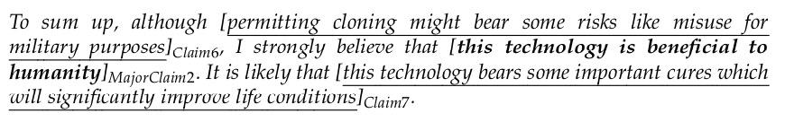
Essay Argumentation
Essays contain elementary discourse units such as MajorClaims, Claims, and Premises.
There is a set of typed relations that can be drawn between the units.
System must identify units and relations to predict score.
From: Parsing Argumentation Structures in Persuasive Essays

Slide 44
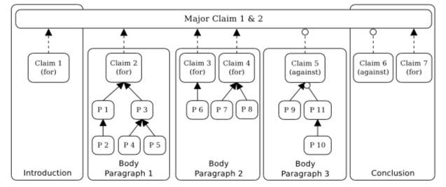
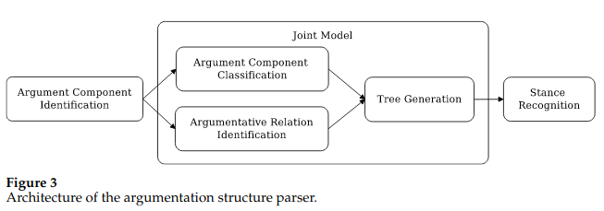
Argument Structure Parser
Parser must identify and classify all of the argumentation units using pipeline below
Arguments and relations are assembled into tree structure
Well formed essays have well formed trees
From: Parsing Argumentation Structures in Persuasive Essays

Slide 45
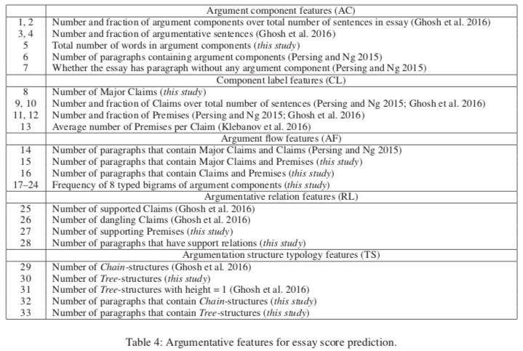
Argument and Essay scoring
System identifies argumentative features and combines with open-source Automated Essay Scoring system.
They achieve best results when they include all features except (RL) relation features.
From: Argument Mining for Improving the Automated Scoring of Persuasive Essays

Slide 46
Next Week: Information Retrieval

Slide 47
End

